Slide 1

Indian Institute of Information Technology, Pune Department of Computer Science Engineering
Minor Project Review
on
“Stock Market Analysis and Prediction using NARIMA”
By
Group No.: CSE11
MIS No. | Name of Student
111615013 | Dheeraj Jutury
111615010 | Bharadwaj Dhornala
Guide
Dr.Jayadeep Pati

Slide 2
Stock Market analysis and Prediction using NARIMA
Project Area : Neural networks and data analytics

Slide 3
Outline
Motivation
Aim
Objective
Problem Statement
Purpose & Scope of the project
Software Requirements Specification (SRS)
Design of Project
UML Diagrams
Plan of Project
Hardware & Software Requirements
System Architecture
Applications of Proposed System
Conclusion
References

Slide 4
Motivation
Why thought of this project?
Stock Market prediction is the act of trying to determine the future value of a company stock or other financial instrument traded on an exchange. The successful prediction of stock’s future price could yield significant profit. This was my main motive.

Slide 5
Motivation
Need of the project
The need of the project is to help share holders to invest their money wisely.
Effective prediction systems indirectly help traders by providing supporting information such as future market direction.

Slide 6
Aim
The aim of this project is to build neural network and train dataset of
various stock closing values which were predicted by ARIMA model.
The aim of the project is minimize the error between the actual stock closing values and the predicted stock closing.
The aim of the project is to predict the values close to the actual values of stock market.

Slide 7
Objective
To calculate the parameter values of ARIMA model.
To forecast the values using ARIMA.
To train the dataset of predicted values by ARIMA.
To improve the accuracy by adding error terms in dataset.
To test the dataset.
To predict stock values more accurately.
To reduce linear and non-linear error.

Slide 8
Problem Statement
To predict the closing values of a stocking market accurately by reducing the linear error caused by ARIMA model and the non-linear error caused by neural network.

Slide 9
Purpose & Scope of project
To train the neural network so that it can predict the stock values.
Successful prediction of stock values could yield significant profit.
To minimize the error between actual values and predicted values.
Future scope of this project can be trading in equity, lie detection.
The concept and architecture of this project can be used in the various areas like weather forecasting, astrology ,future healthcare, education, fraud –detection etc.

Slide 10
Software Requirements Specification (SRS)
Link to SRS goes here.
Standard SRS format (already shared) should be followed.

Slide 11
Design of Project
Number of modules : 4
Names of modules:
1.Neuralnet
2.forecast
3.tseries
4.Quantmod

Slide 12
UML Diagrams
Use Case Diagram:

Slide 13
UML Diagrams contd..
Class diagram
User
+Name
+Train Data/Test Data
+operation1(arg list): provides input sample
+operation2(arg list): provides test data
Network
+Type of network
+Number of hidden layers
-Sample dataset
-Test Data
+pre-processing of data ()
+extraction of features ()
+comparison of features ()
+display of percentage ()

Slide 14
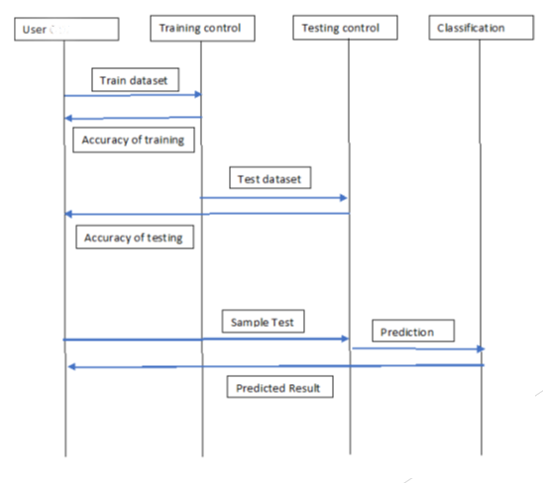
UML Diagrams contd..
2.9 Sequence Diagram:

Slide 15
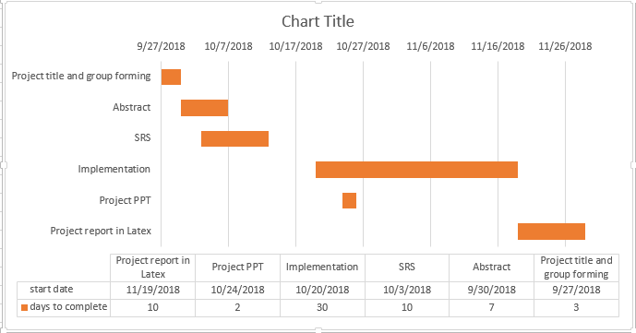
Plan of Project
Gantt Chart

Slide 16
Hardware & Software Requirements
Hardware Requirements
SYSTEM: Intel Core i5 7th Gen
HARD DISK: 1TB
RAM: 8GB
Software Requirements
Operating system: Windows 10
Programming language: R Studio
R Modules: neuralnet, forecast, tseries.

Slide 17

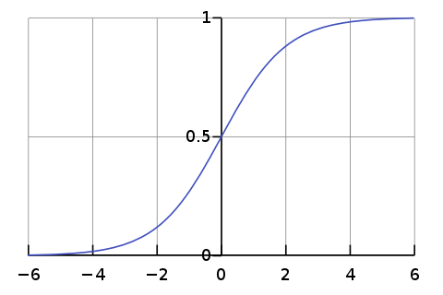
Algorithm: Activation Function
A sigmoid function is a mathematical function having a characteristic “S”-shaped curve or sigmoid curve. Often, sigmoid function refers to the special case of the logistic function shown in the figure and defined by the formula

Slide 18
Algorithm:
Back Propagation :
Backpropagation is a supervised learning algorithm used for training Multi layer neural network to calculate a gradient that is needed in the calculation of the weights to be used in the network. Backpropagation is shorthand for “the backward propagation of errors”, since an error is computed at the output and distributed backwards throughout the network’s layers.

Slide 19
Applications of proposed system
The main application of this project is to predict stock values.
Used in Education,
Future Healthcare
Fraud Detection
Astrology
Weather Forecasting
Criminal Investigation

Slide 20
Conclusion
This usually serve two functions-
The first step is to calculate the forecast values using ARIMA model.
the second step is the train the neural network with the predicted values of ARIMA model and also adding the error term.
This project is undertaken to design NARIMA model(neural network +ARIMA ) and evaluate the stock values by minimizing the error.
This study has found that results obtained by best ARIMA model is used to predict stock values.

Slide 21
References
Ayodele A. Adebiyi, Aderemi O. Adewumi “Stock prediction using ARIMA model”,2014 UKSim-AMSS 16th international conference in Computer Modulling and stimulation.
www.rbloggers.com
www.datascience.com
www.analyticsvidhya.com

